Slide 1
PROJECT 0
Project name : banking account application
Author : hoang le

Slide 2
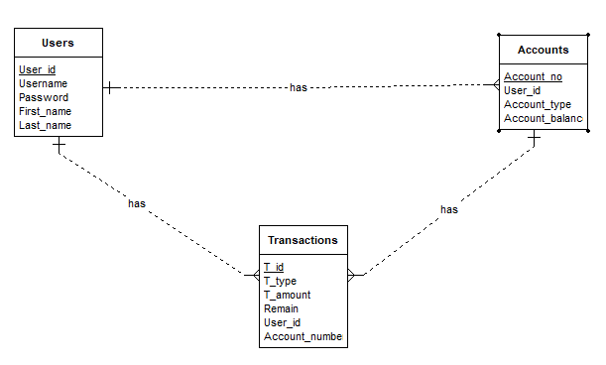
ERD

Slide 3
Main functions
Register new account
Check if Username are Available
Create a new Saving or Checking account
Login
Check username and password
Check what type of account that user have
Ability to create account that user don’t have
Choose account to work with :
Deposit
Withdraw

Slide 4
DEMO

